Slide 1
Final Project Every day Problem
Unit 11 and 12

Slide 2

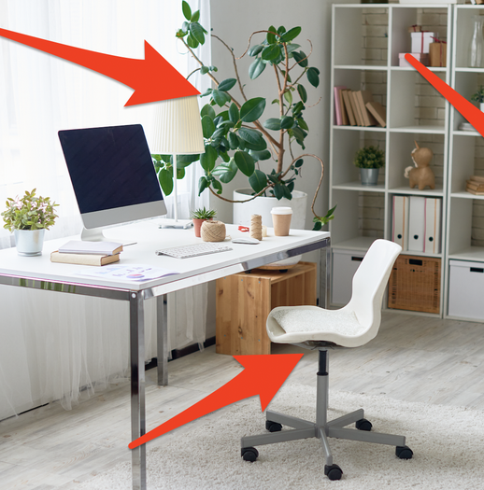
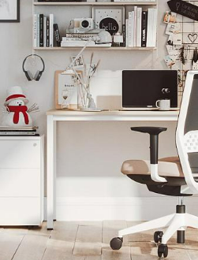
Keep it simple but significant
needs to be upgraded

Slide 3



How to Solve
keep it special and full of life

Slide 4

Behavior

Slide 5
